Slide 1



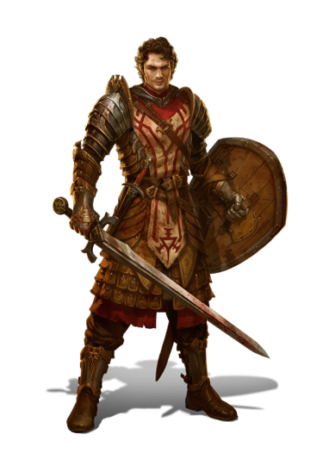
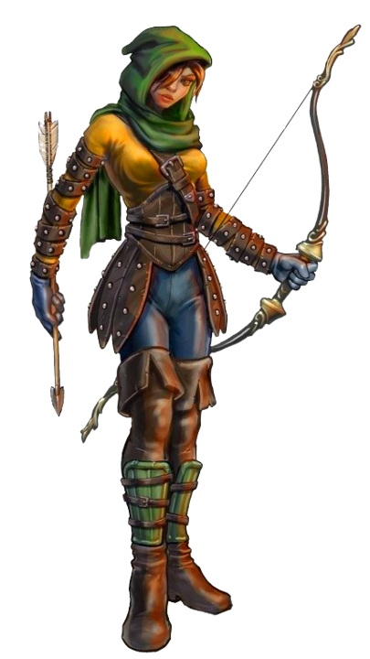
Decision Tree
CS1A
By:
Christian Caparroso, Bethany Tooley, Garrett Weitz, and Ben Northroup

Slide 2
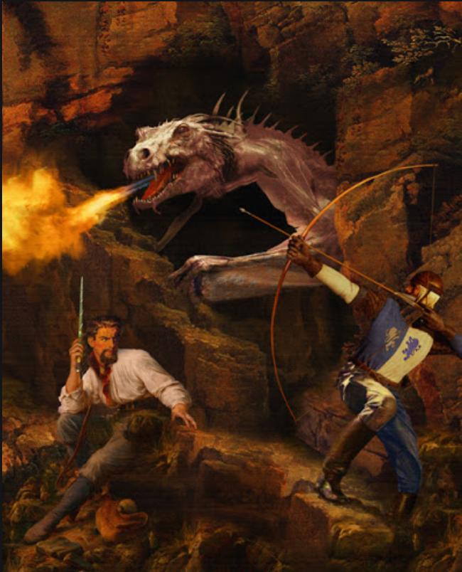
Introduction
The program will take the user, an unaccompanied protagonist, through different scenarios pertaining to each specific choice they make. The story takes place in a forest where your survival is imminent, and your fate is concealed by the choices that you make leading up to the end. Getting to choose your own adventure as the protagonist who chooses their own fate through the plot that leads to many options that will then lead to one of many endings.

Slide 3
Algorithm
Game Starts: User picks starting weapon.
First Story Decision: Left or Right Path.
Player goes into the town
Player goes into the forest
Player Fights the Dragon
Player Ignores the Dragon
Player sneaks by the Bear
Player fights the Bear
If no weapon is chosen
If no weapon is chosen
Game Over :(
Game Over :(
Beat the Dragon!
Escape the forest!

Slide 4
Algorithm: Function template
Boolean variable invalid is set to true by default
setfill() -> Used to set dashes at top
couts are then used to output the story on the screen
setfill() -> Used to set dashes at bottom to mark end of story text
If a decision has to be made then prompts user with a question and allows input
Stores input as a char
A while loop runs invalid is false
Switch statements checks all cases to see if they match the char the user input
If none match then loop runs again
If a case matches then function returns decision number/runs next function in the story and sets invalid to false

Slide 5
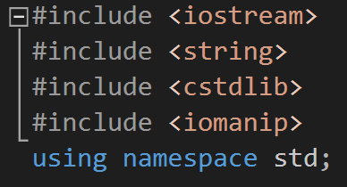
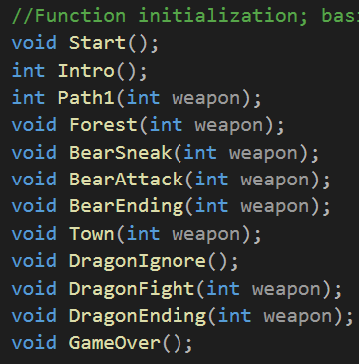
Function Initialization
These are the libraries used for the program. String is to allow the user to have string inputs, cstdlib is for the screen clearing, and iomanip is for the cout formatting.
This section of code initializes the functions that are defined later in the code. They are declared now so when they are called the program knows they exist.

Slide 6
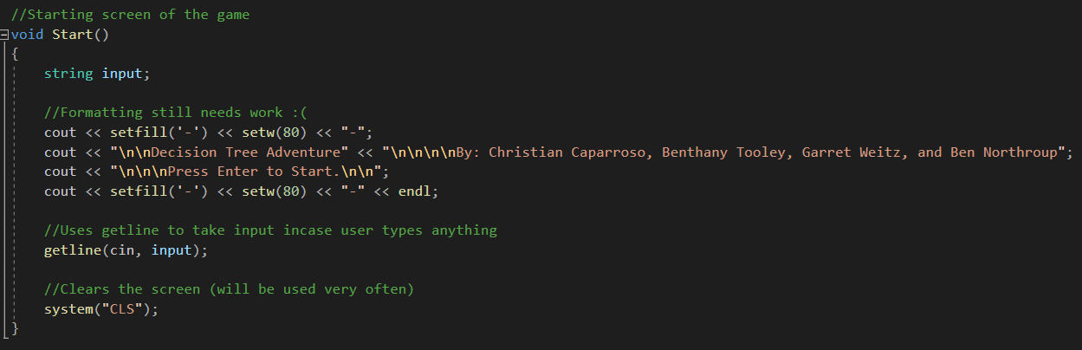
Start Screen
Examples of setfill() being used to print out a line of dashes at the top and bottom of each “page” of the story
The Start() function serves as the beginning screen for the story. It allows for the user to input anything as long as they just press enter at the end to begin the story. system(“CLS”) is used frequently to clear the screen of the program.

Slide 7
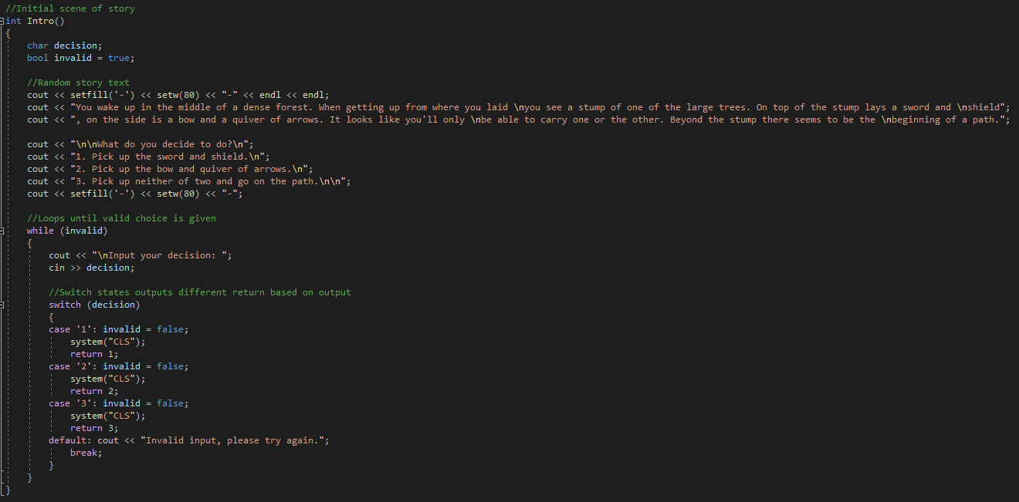
Beginning of Story
Decisions are initialized as switch cases ‘1’, ‘2’, and ‘3’.
A while loop is used for invalid input from the user until a correct choice has been chosen
Outputs from each switch statement including a system command to clear screen if invalid input is given.
The function int Intro() begins the start of the story, containing the story introduction and three decisions the user can choose. The three decisions will have its own correspondence to each plot created as the story continues.

Slide 8
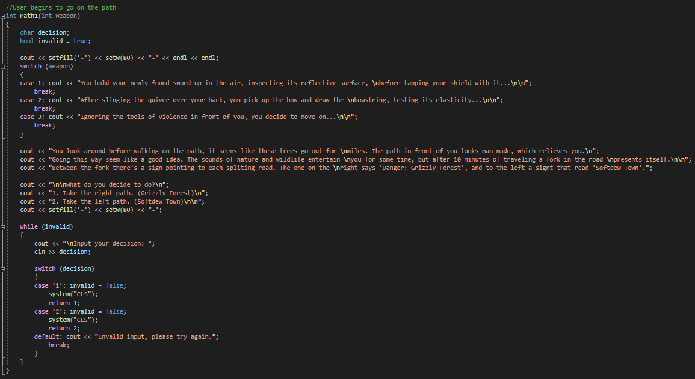
First Decision
The function Path1 sets up the first main decision in the game deciding whether the player wants to enter the forest or enter the town. Based on their decision, the function returns a different value: 1 = Forest and 2 = Town.

Slide 9
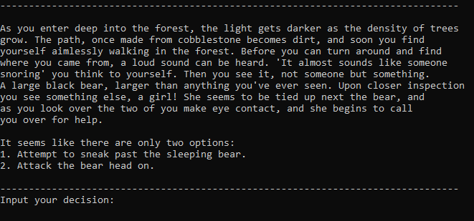
Choice 1: Forest Path
Two decisions are given to the user. What weapon you choose will determine what your fate is.

Slide 10
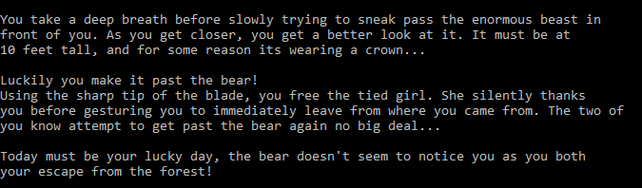
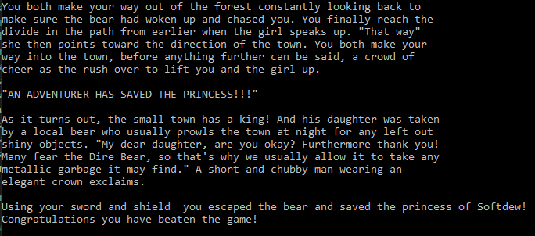
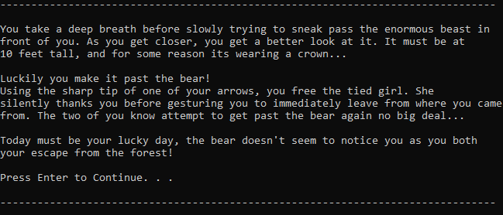
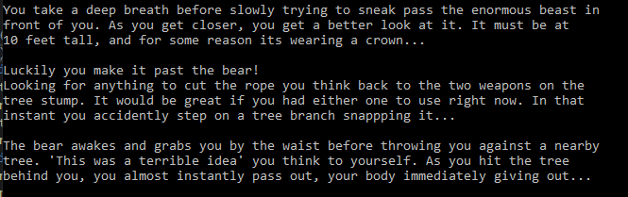
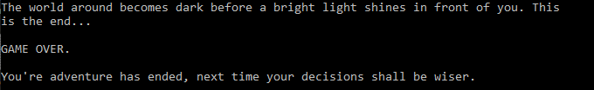
Fate of the Forest Path: Decision 1
User wins!
If sword and shield was picked.
If bow and arrow was picked.
Game Over!
If no weapon was picked

Slide 11
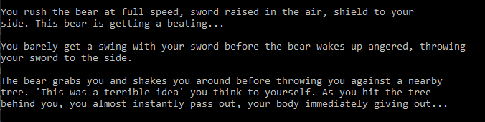
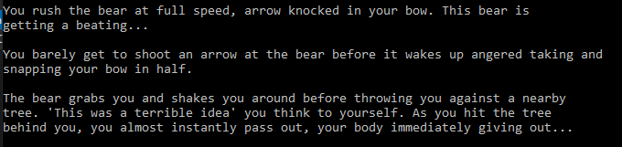
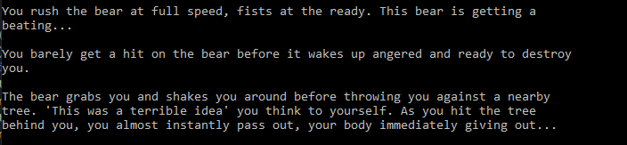
Fate of the Forest Path: Decision 2
If sword & shield was picked.
Game Over!
If bow & arrow was picked.
If no weapon was picked

Slide 12
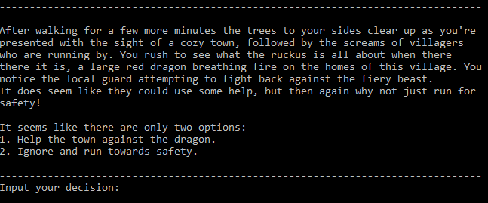
Choice 2: Village Path
Two decisions are given to the user. What weapon you choose will determine what your fate is.

Slide 13
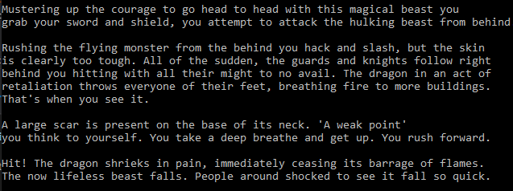
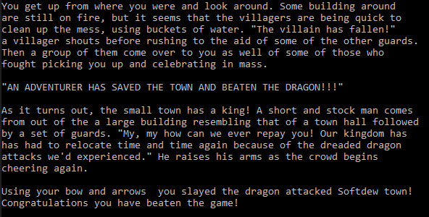
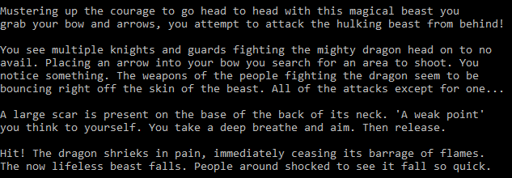
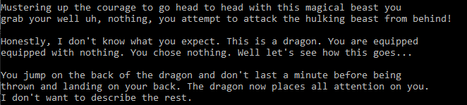
Fate of the Village Path: Decision 1
User wins!
If sword and shield was picked.
If bow and arrow was picked.
Game Over!
If no weapon was picked

Slide 14
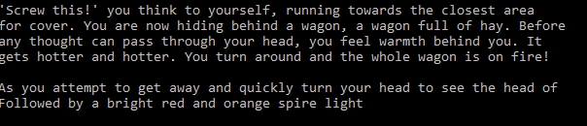
Fate of the Village Path: Decision 2
Game Over!
No matter what weapon you choose in the beginning, running past the dragon will result in imminent death.

Slide 15
Works Cited
zyBooks. (2020). Retrieved 20 April 2020, from https://learn.zybooks.com/zybook/SADDLEBACKCS1ASolerSpring2020
How do I clear screen? - C++ Forum. (2020). Retrieved 21 April 2020, from http://www.cplusplus.com/forum/beginner/3304/

